Slide 1
AA Bus Stops Network Assessment
Haolin Li 12/10/2024

Slide 2
Research Questions
(Analysis) What is the network structure of Ann Arbor's bus stop network? (for example, degree distribution, centrality, etc)
(Visualization) Which stops are important in the network? How are they distributed?
(Analysis) Which areas have relatively higher density of bus stops? Are they aligned with the busy areas of Ann Arbor?
(Visualization) According to LODES data, which census blocks are the most connected?
(Analysis) How will the commuters use the bus system? How efficient the bus network is to them? Or more specifically:
What percentage of commuters have direct bus routes between their workplace and their residence?
How does that change w/wo the new route (104)?
(Visualization) For the commuters who works at UM Campus, where do they live?

Slide 3
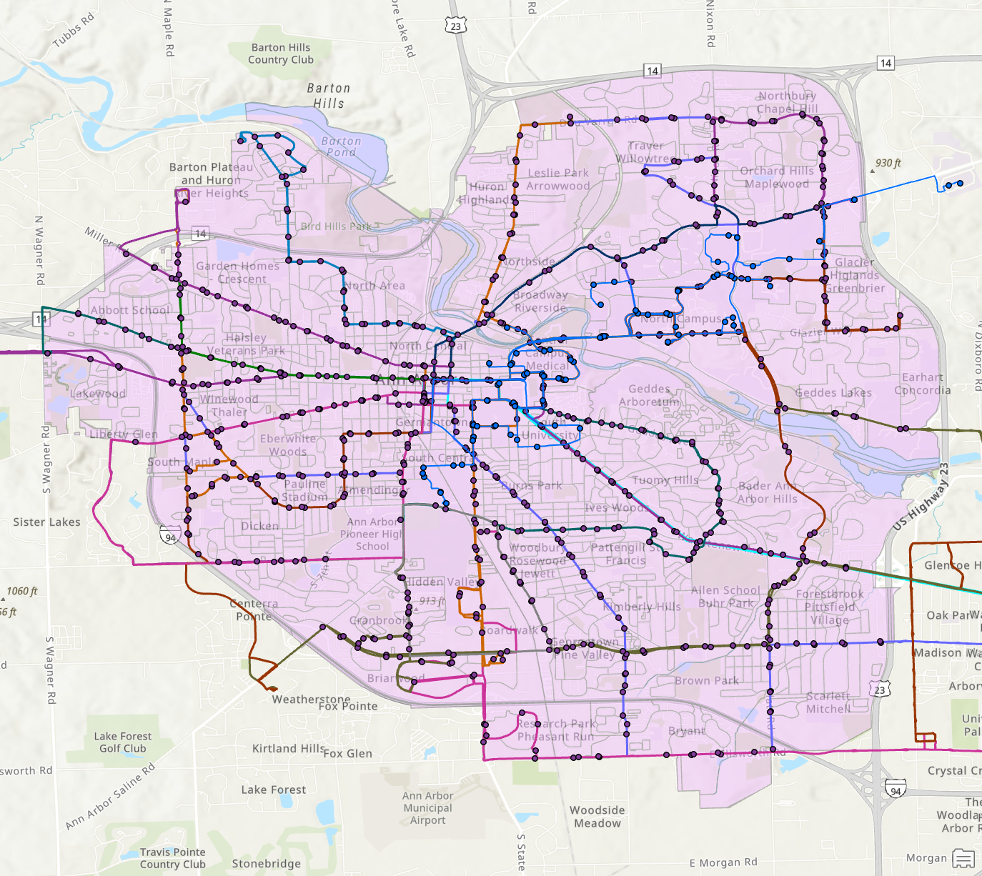
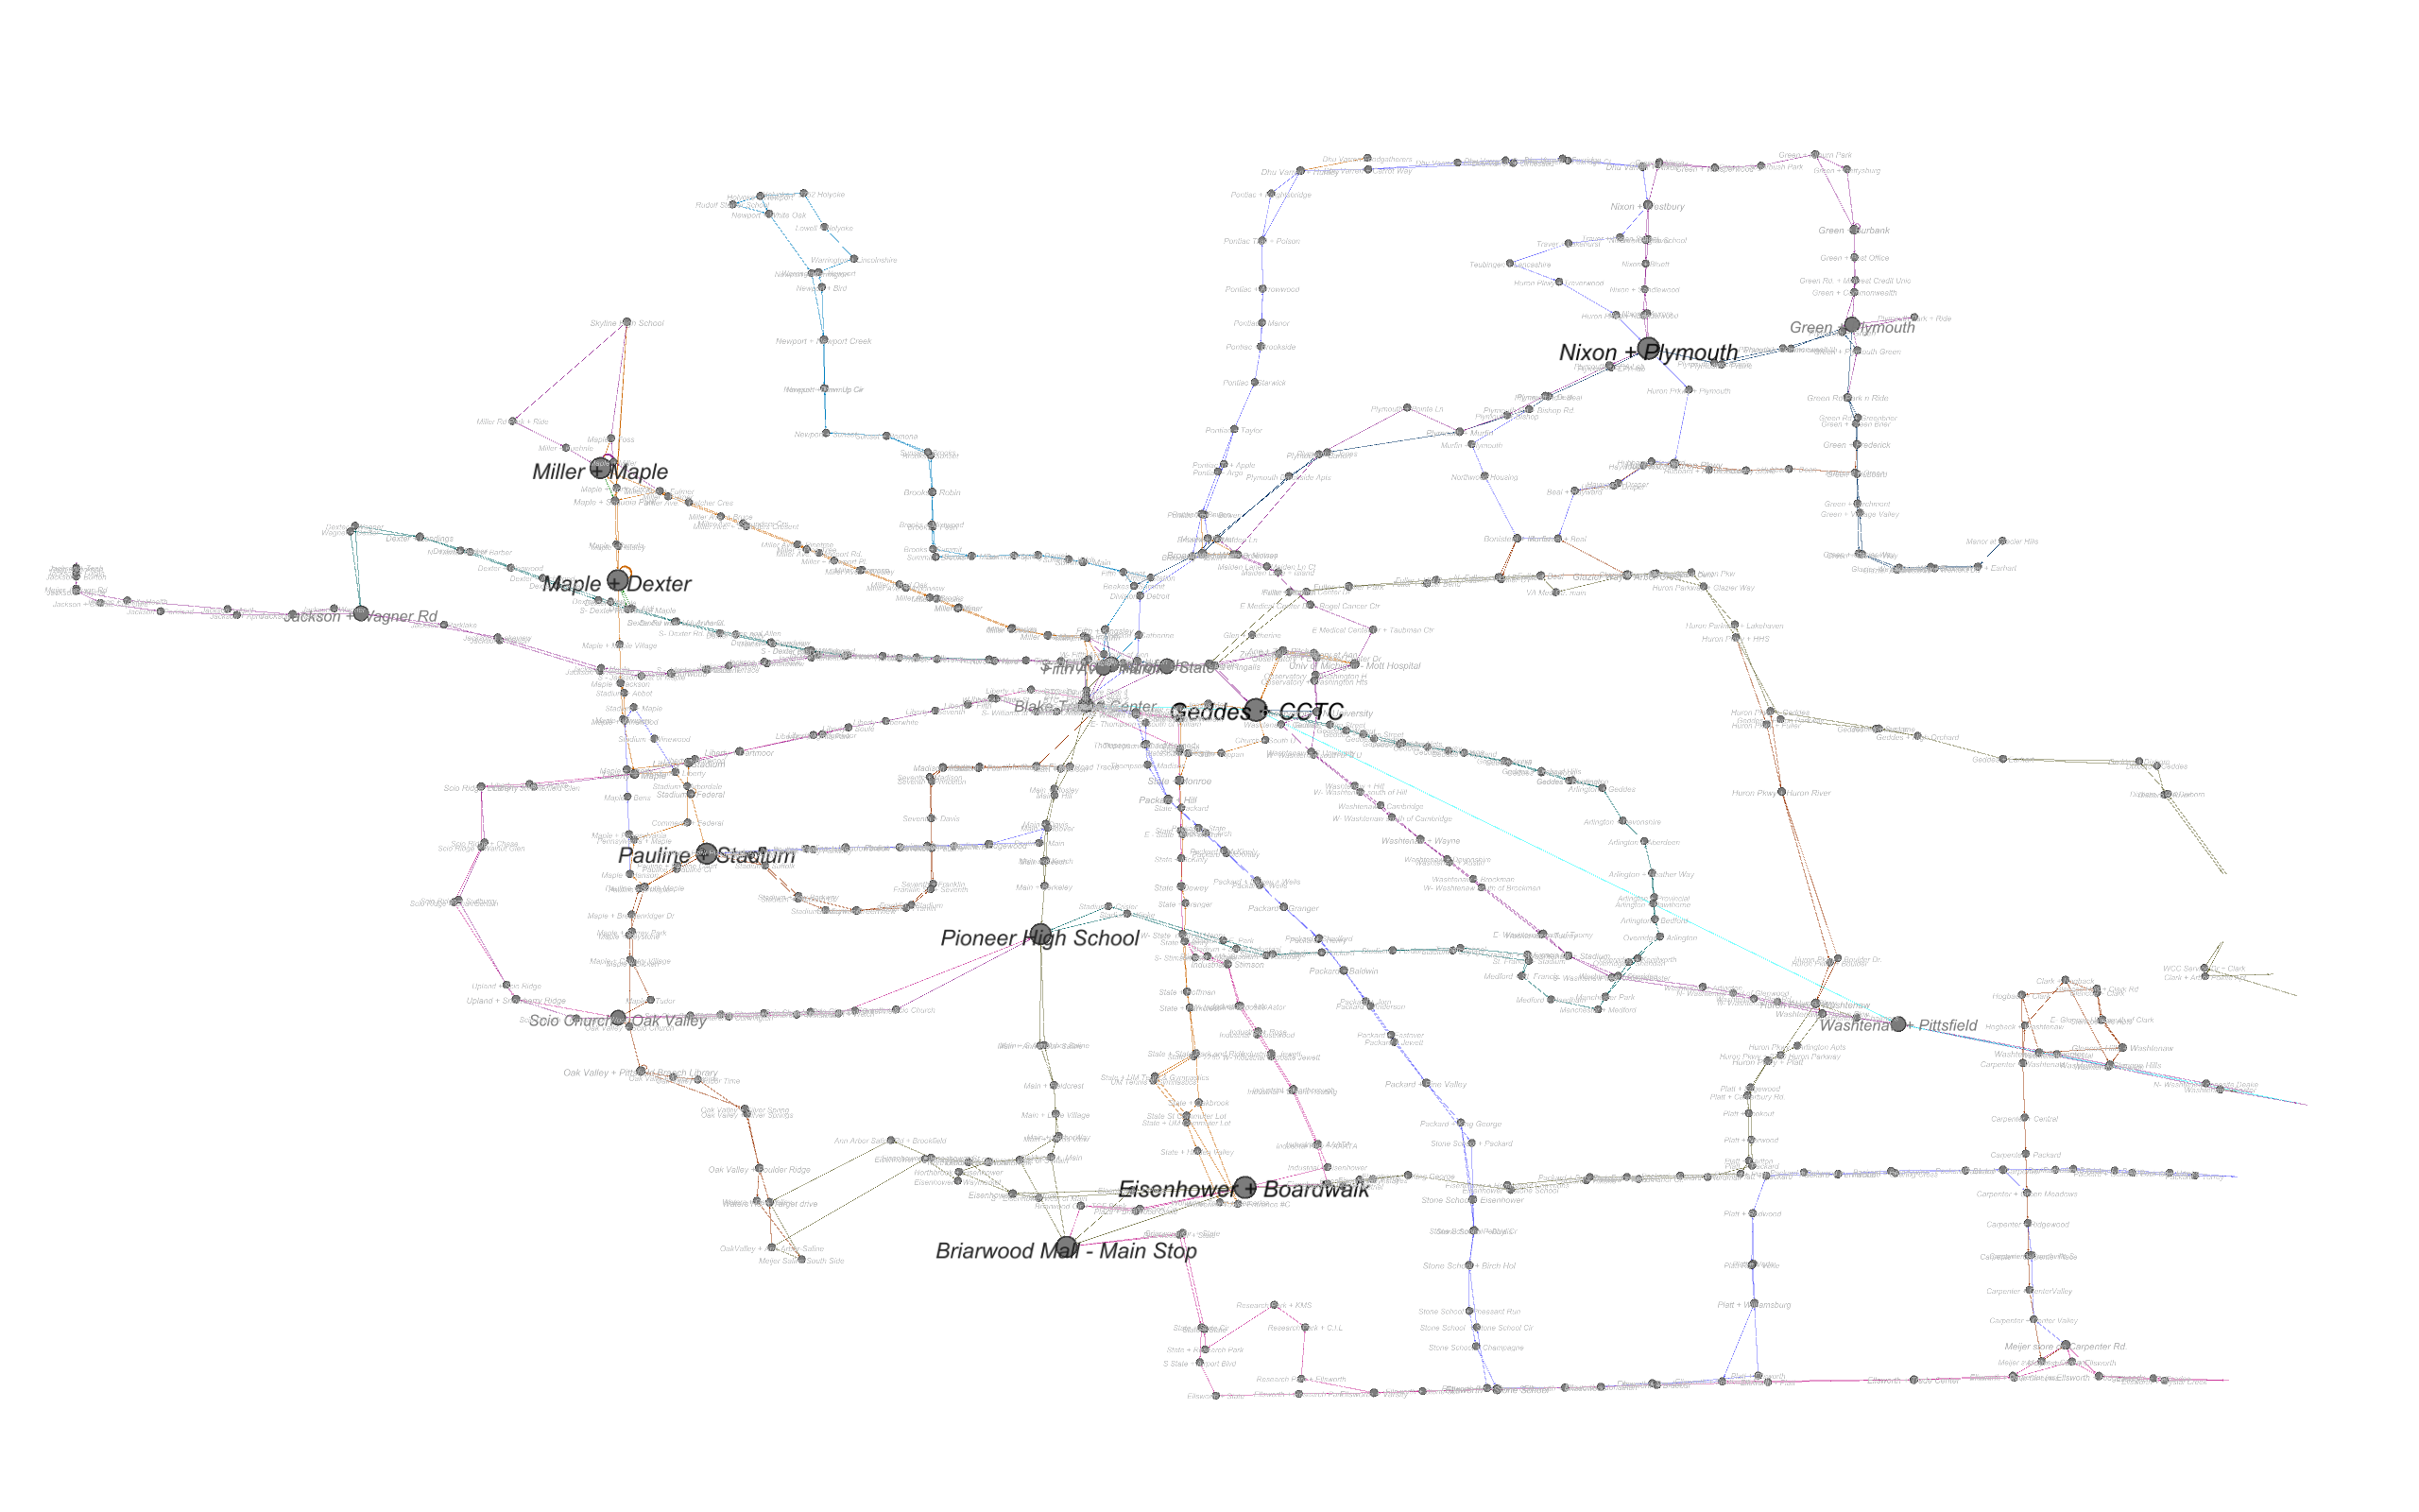
Data
Project & Dataset
GitHub
Published Network Data
ArcGIS Web Map
AATA Bus Route Data (GTFS)
AATA Bus Stop data
Ann Arbor Streetlights data
Ann Arbor Boundary data
Tiger/Line data product (Census Blocks)
LEHD Origin-Destination Employment Statistics (LODES) Dataset
M-Bus Tracking Data (Web Crawler)

Slide 4
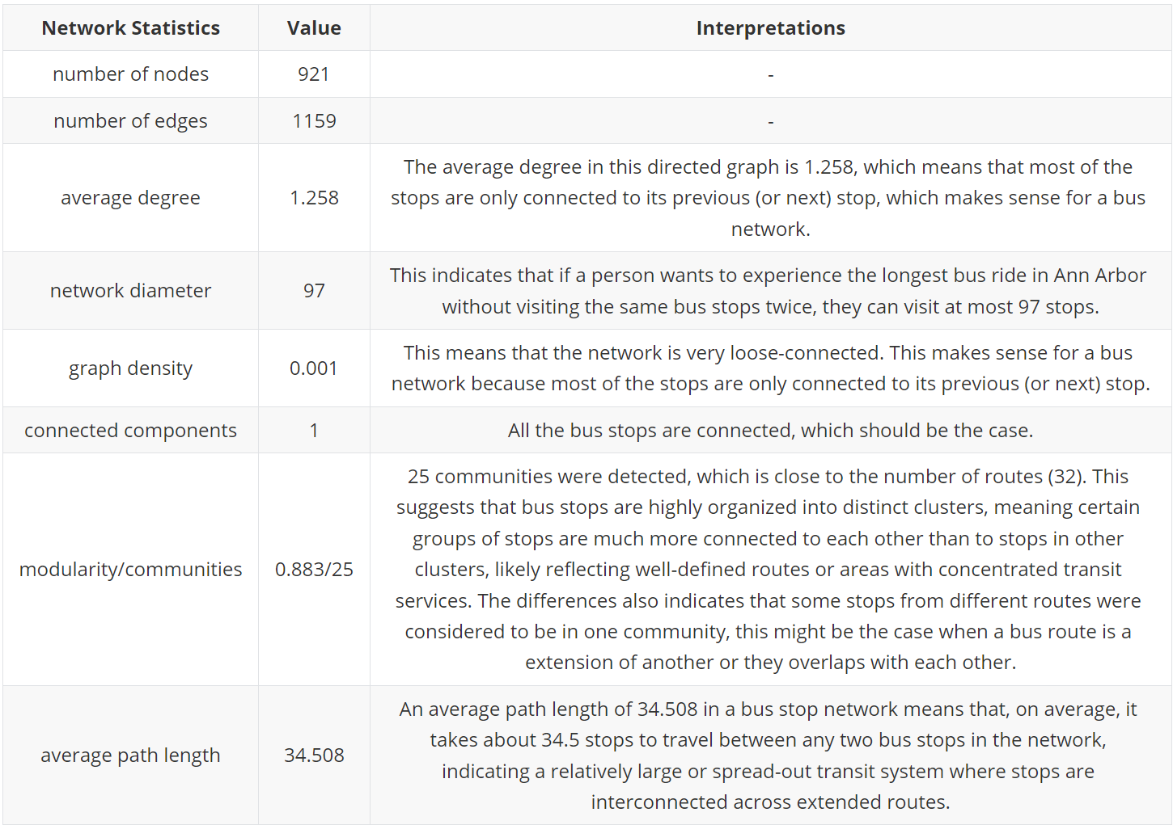
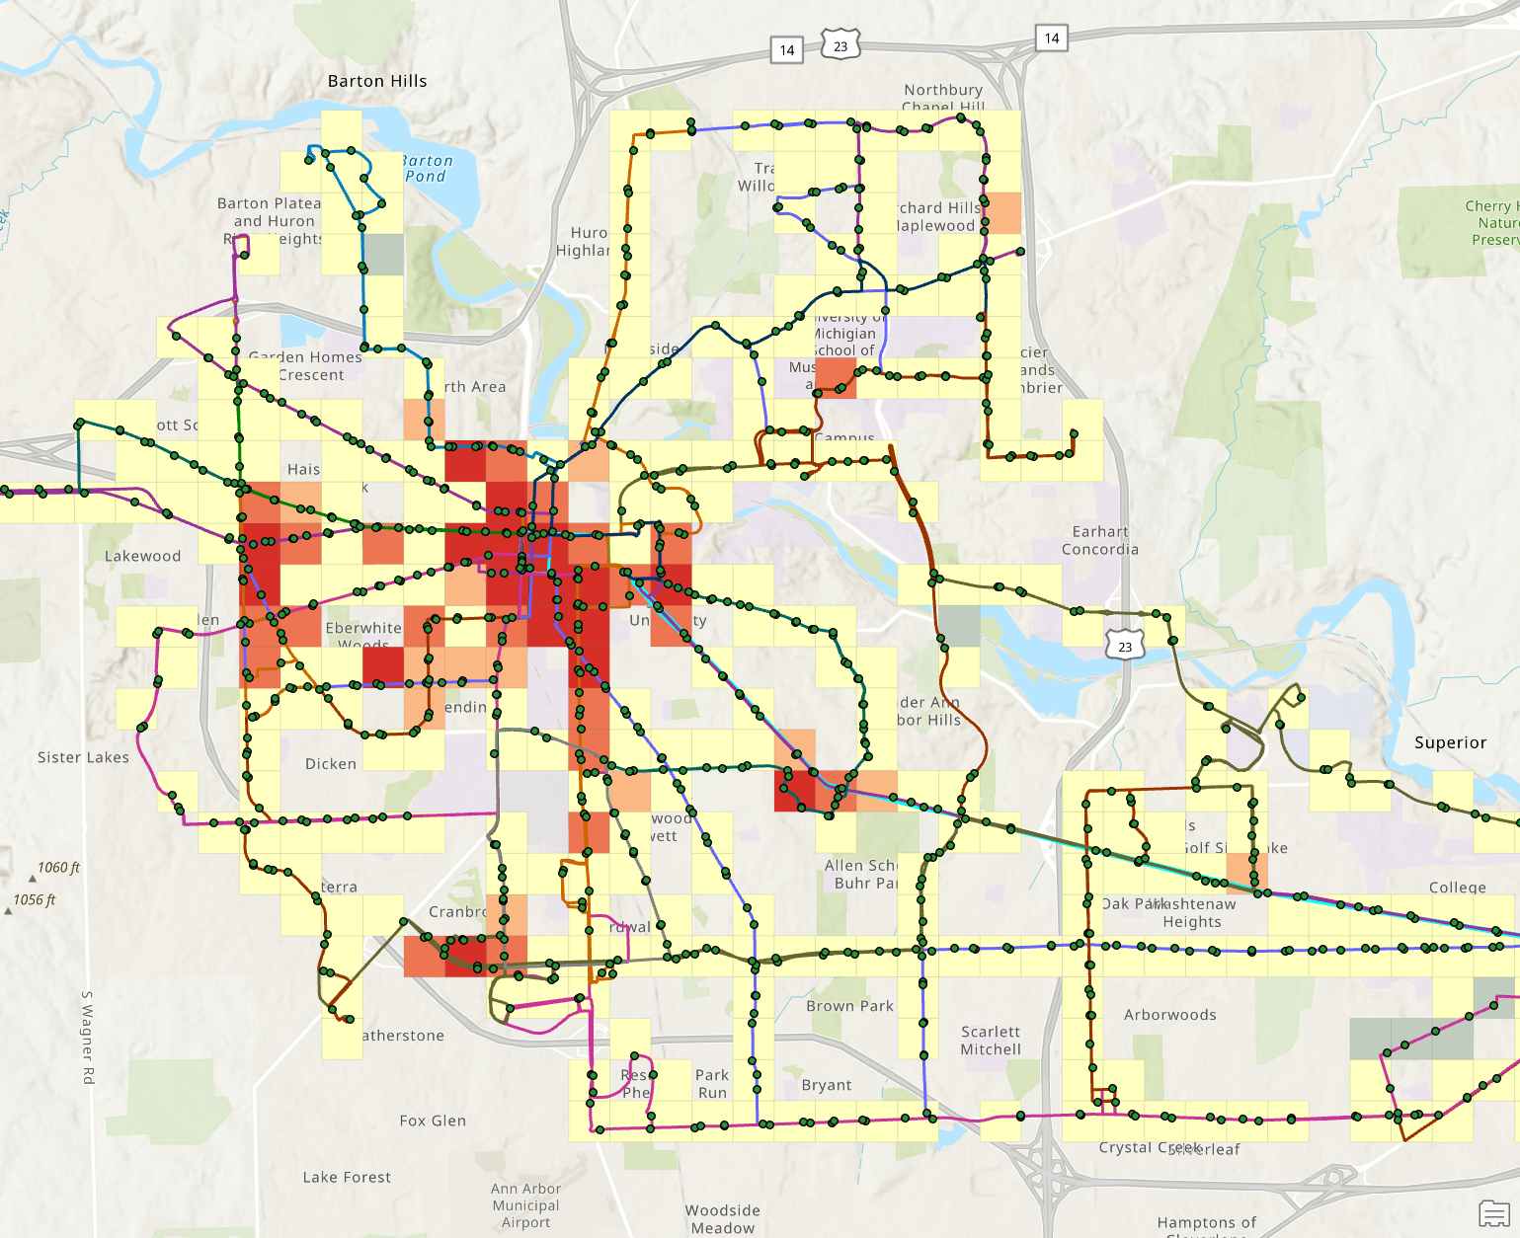
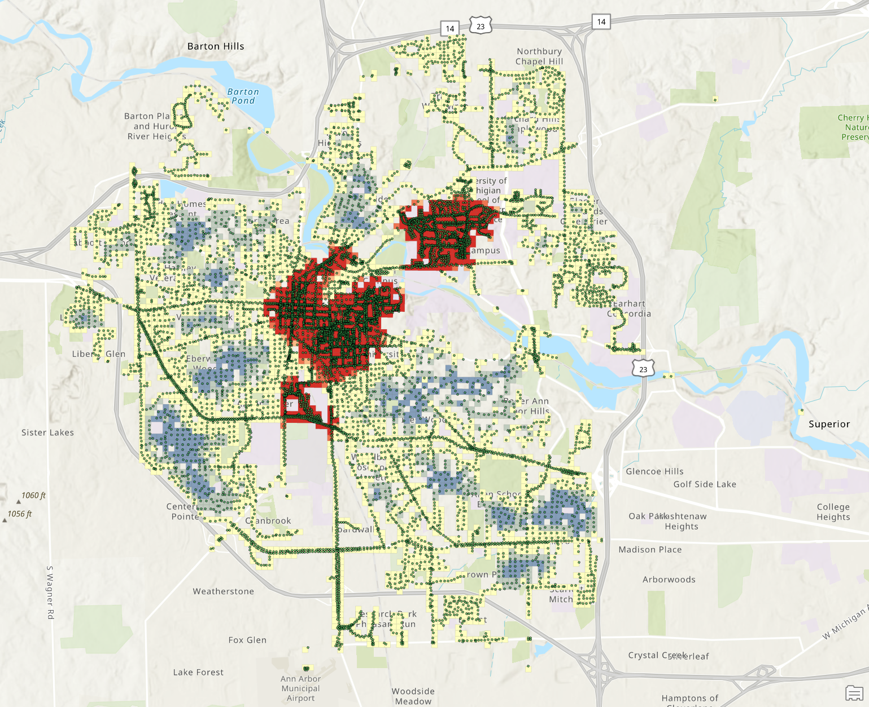
Outcomes

Slide 5
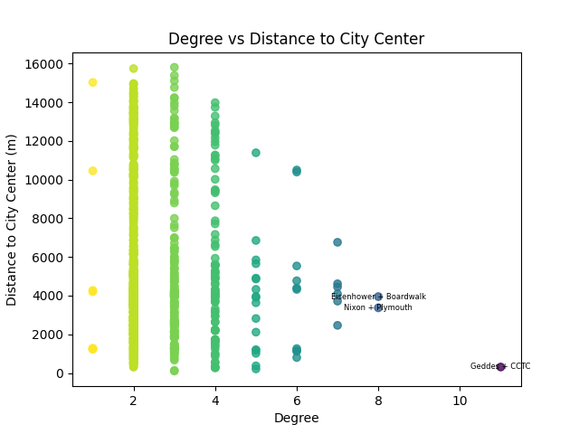
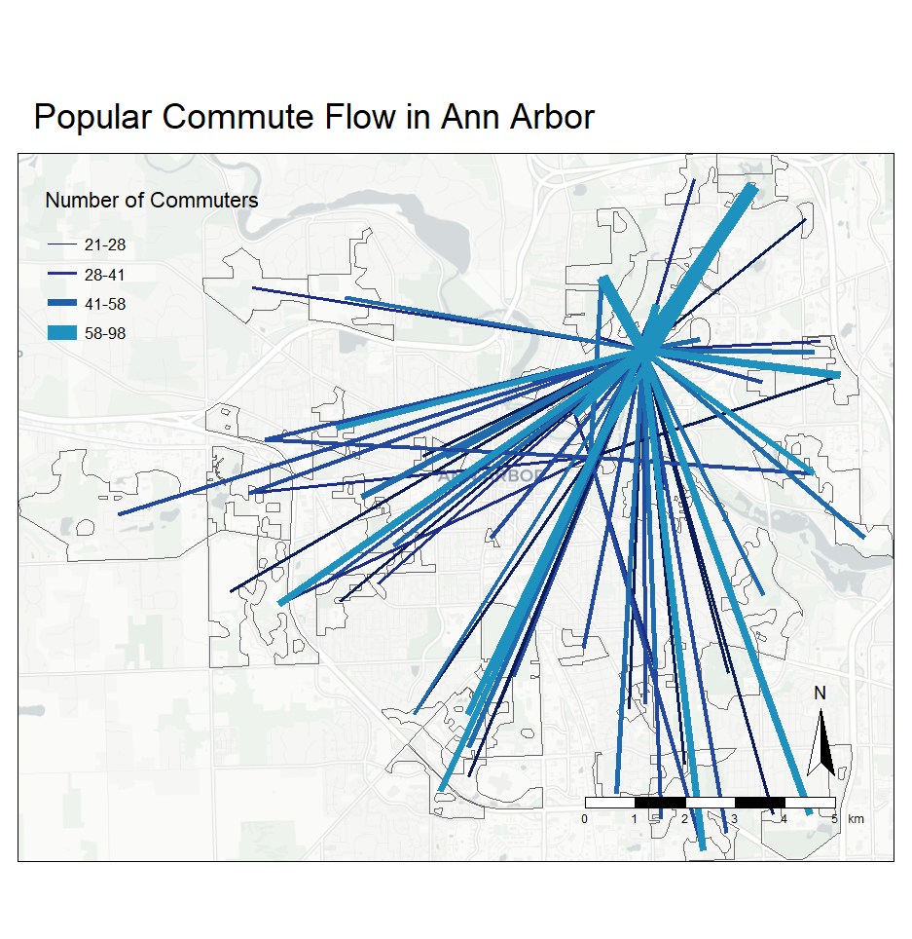
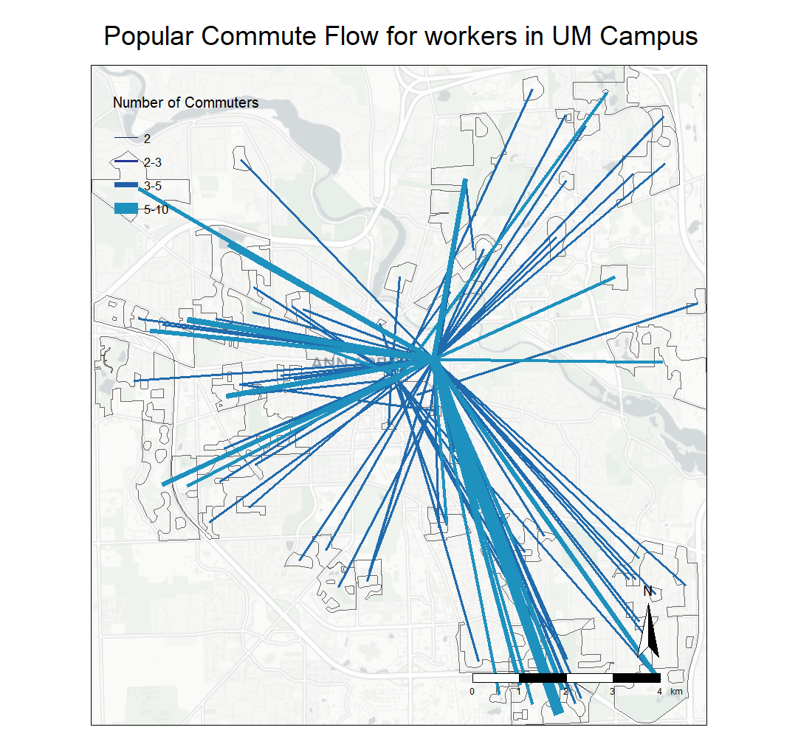
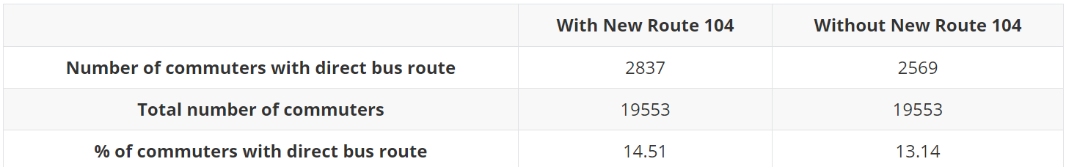
Outcomes

Slide 6
Thank You~
Questions?

